Slide 1


Christmas 2024

Slide 2
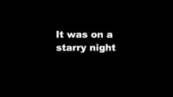

Slide 3
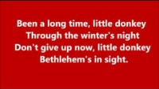

Slide 4


Slide 5

https://youtu.be/nEH7_2c644Q
Silent Night

Slide 6
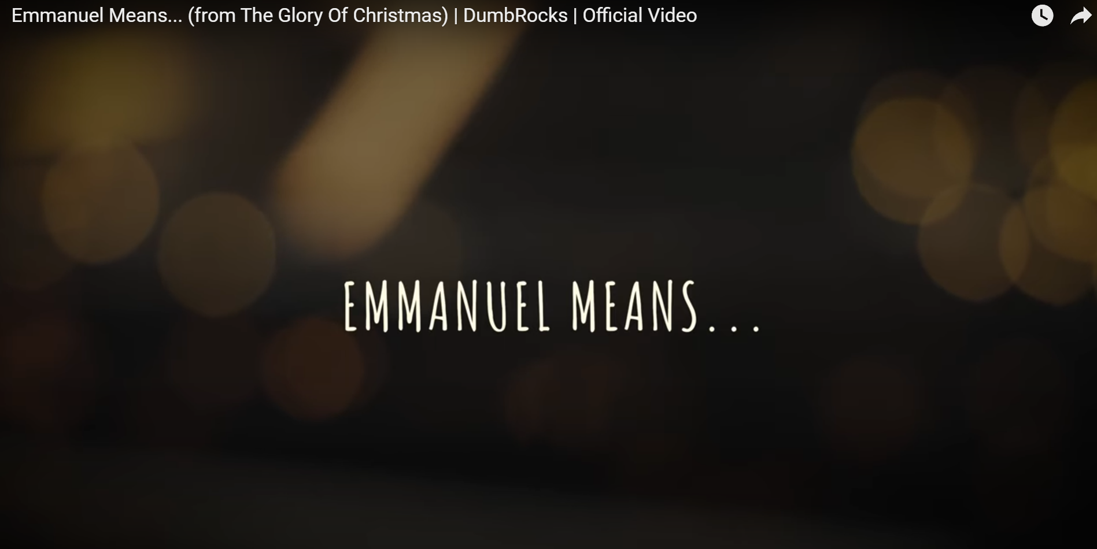
https://youtu.be/-tYm7bHOP1Y?si=bHbuDd6NkzZ4z2DT
Emmanuel Means... (from The Glory Of Christmas)

